Slide 1



tsDetect An Open Source Test Smells Detection Tool
Rochester institute of technology
https://testsmells.github.io/

Slide 2
Test smells indicate potential design problems in the test source code
Test smells are defined as bad programming practices in unit test code
(such as how test cases are organized, implemented and interact with each other)
tsDetect is an open source tool that detects JUnit based unit test smells

Slide 3
Demo

Slide 4
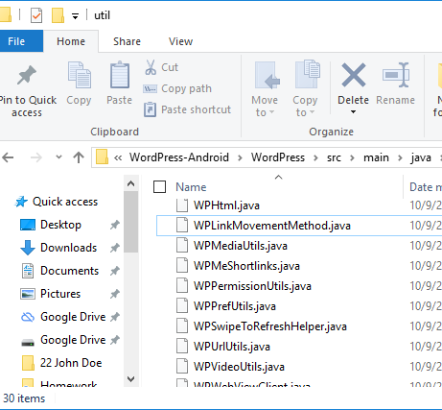
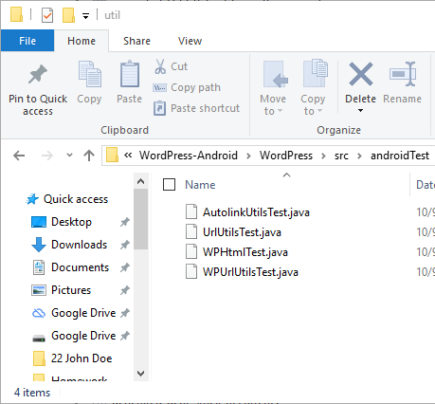
Typical Project Setup
Production Files
Unit Test Files
Tested Production Files

Slide 5
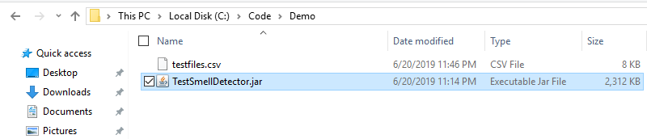
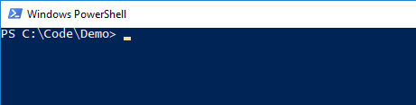
Tool Usage
Download tsDetect from: https://testsmells.github.io
Open a command line / PowerShell window in the folder containing the jar file
tsDetect jar

Slide 6
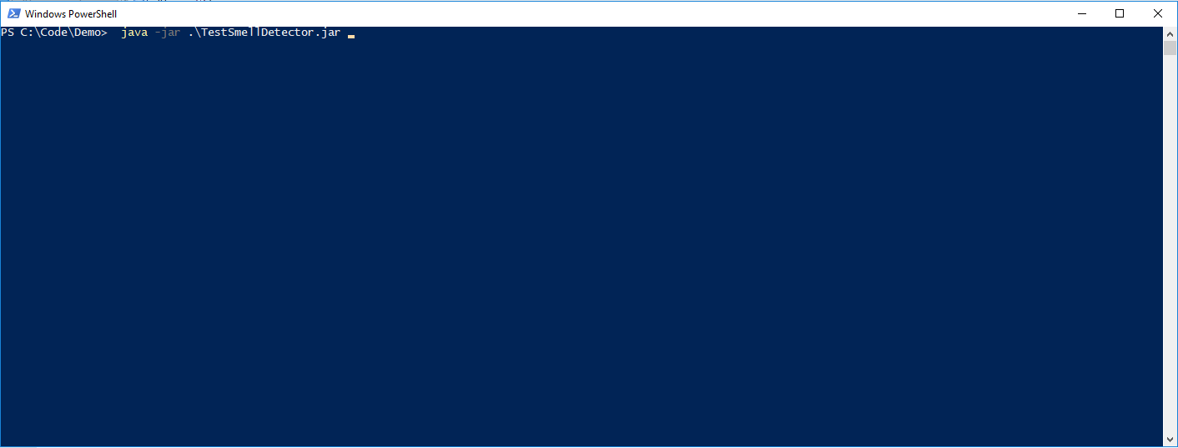
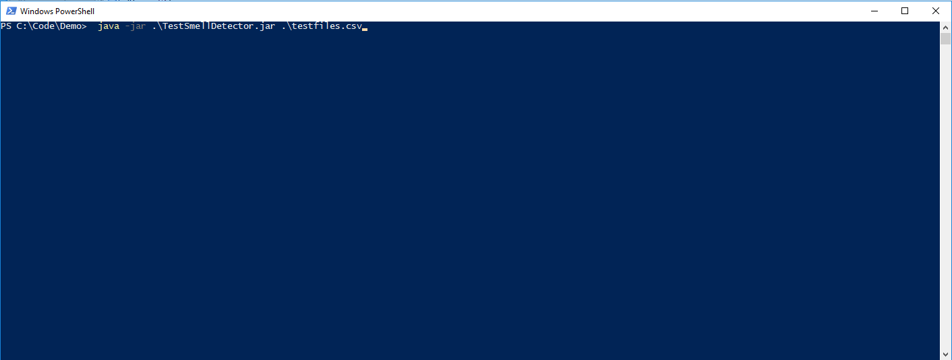
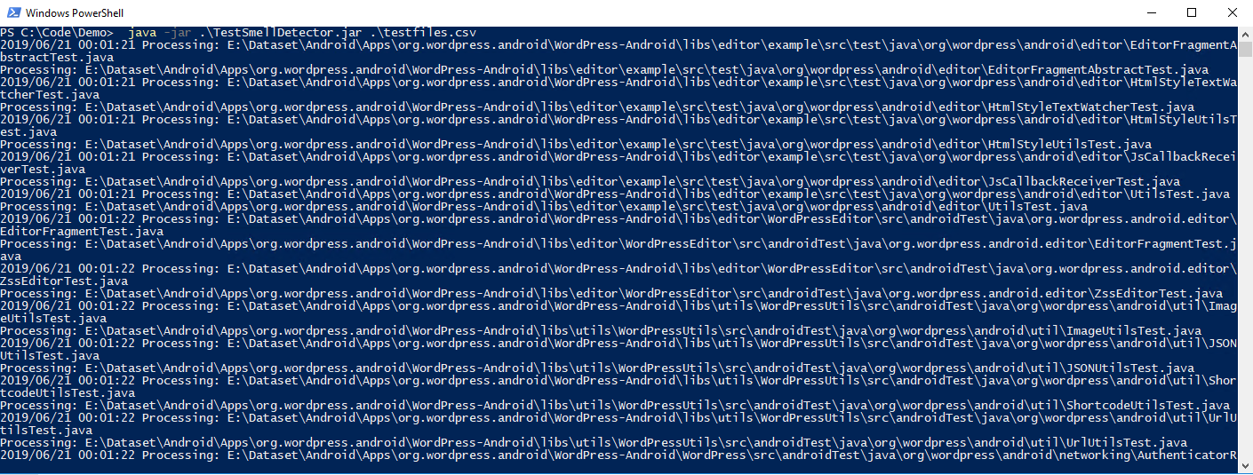
Tool Usage
Run tsDetect using the command: java -jar .\TestSmellDetector.jar pathToInputFile.csv
tsDetect running

Slide 7
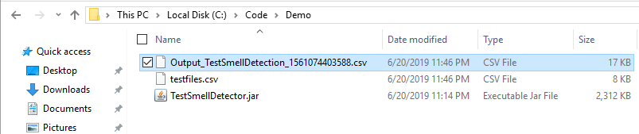
Tool Usage
On completion, tsDetect creates a CSV file containing the results of the execution
tsDetect output

Slide 8
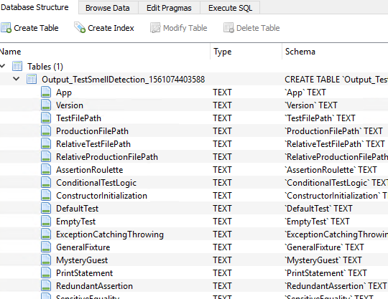
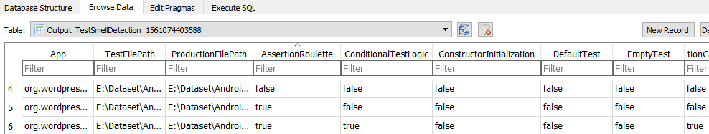
Analyze Results
Import the CSV file into a database management system for analysis or further processing
Status of 'true' indicates that the associated smell exists in the test file

Slide 9
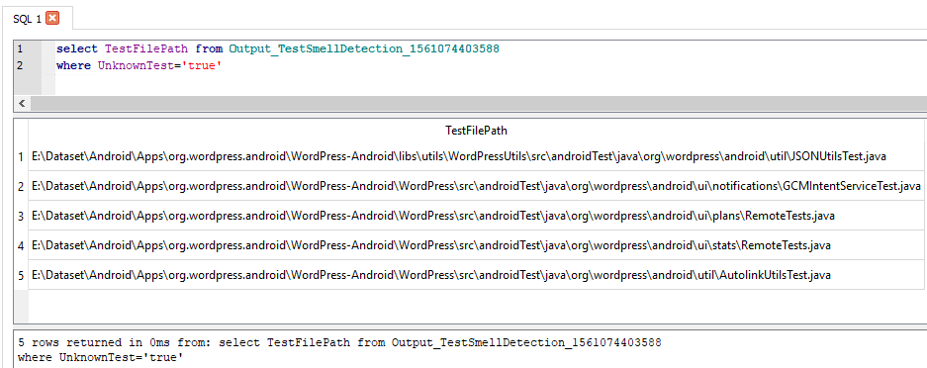
Analyze Results
Import the CSV file into a database management system for analysis or further processing

Slide 10
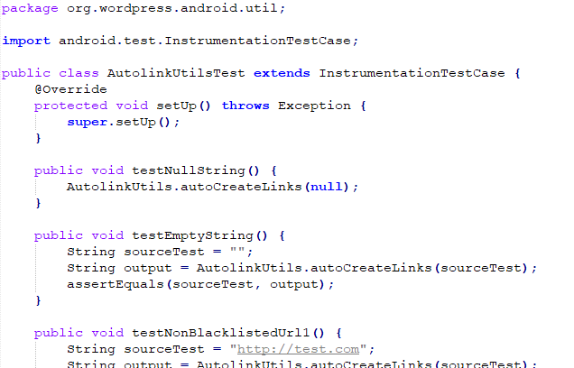
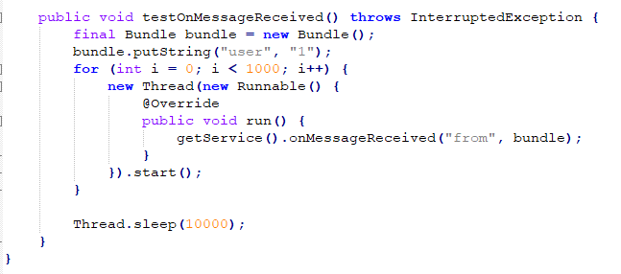
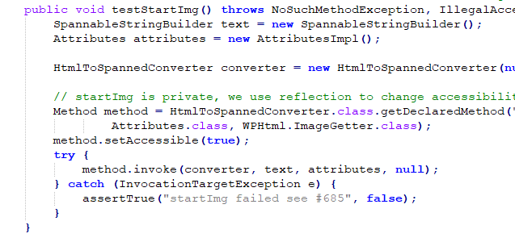
Sample Detections
Unknown Test
Conditional Test Logic
Sleepy Test
Redundant Assertion

Slide 11
Download tsDetect from:
https://testsmells.github.io/

